Slide 1
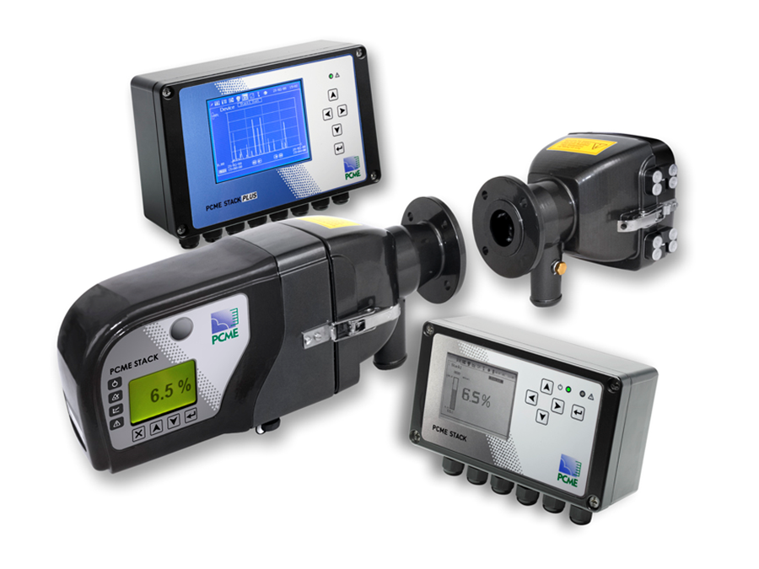

PCME STACK 710 Opacity Measurement System
Roberto Lopez-Garcia

Slide 2
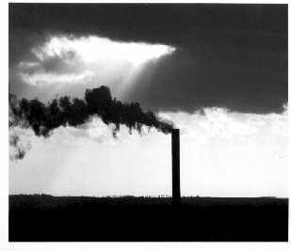
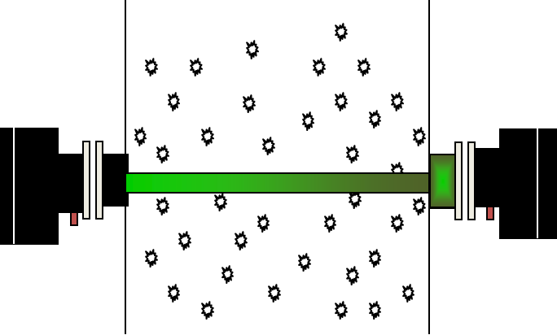
PCME STACK710 Overview
Opacity 100% = (1 – Received Signal/Transmitted signal)
TRANSMITTER
RECEIVER
0 - 20 - 40 - 60 - 80 - 100% Opacity
0 - 01 - 02 - 03 - 04 - 05 Ringelmann (visual)

Slide 3

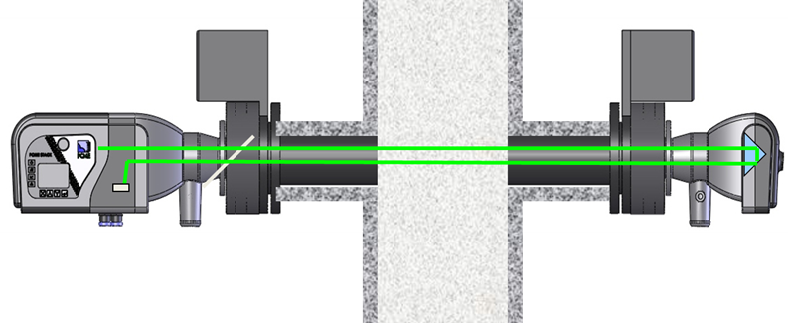

Stack 710 can also be used for Dust Monitoring
Optical Density (extinction) linearises exponential relationship between dust and received light
Extinction = -Log₁₀ (Ʈ)
Extinction = -acl/2.303
Where: n = Concentration of Pollutant
a = Attenuation Coefficient
l = Pathlength
Provides representative dust measurement across large stacks
Optical Pathlenght

Slide 4



PCME STACK 710 Compliance
Meets or exceeds US OPACITY Standards
US EPA requirements for 40CFR60 Sections 13, 17 and App. B PS-1.
Meets or exceeds US EPA requirements for proposed 40CFR60 App. F procedure 3.
Meets or exceeds ASTM Standard D6216.
Certified to QAL1, EN15267-3, 0-15mg/m³ @5m pathlength
* Some limitations (Pathlength)

Slide 5
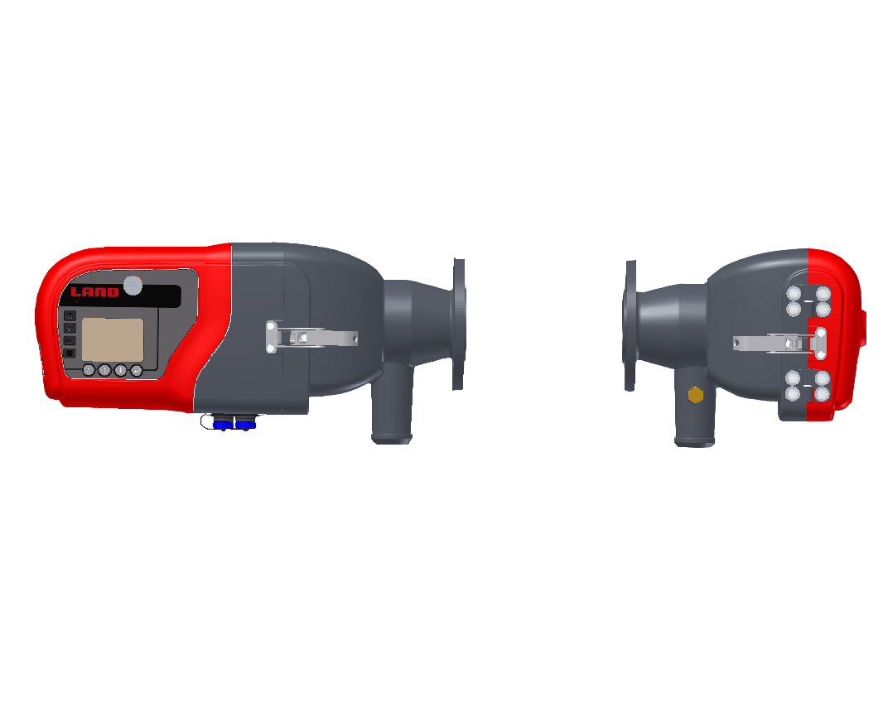
STACK 710 Operation
Zero Offset Mode
Detectors
Beam Splitter
Source LED
Diffusion Filter
Mirror
Span Filter
Zero Point Reflector
Retroreflector
Flood LED
Source and Flood LED off – Measures the electronic zero of the detectors and automatically compensates.
Flood LED on – Determines any gain difference between the measurement and reference detectors and automatically compensates.

Slide 6
STACK 710 Operation
Measuring Mode
Source LED on – The transmitted light intensity is measured by the reference detector, while the reflected light intensity is measured by the measurement detector. Opacity is calculated from the ratio of these.

Slide 7
Reliable Automatic Calibration for High QA
Internal activation or External trigger of check cycles
Contact closure
Modbus
System zero calibration
Corrects for drift
Corrects for dust accumulation on lens
Limited to 4% correction
System span calibration
Verifies upscale operation
The Zero Point Reflector
A Span Filter (typically 25%)

Slide 8
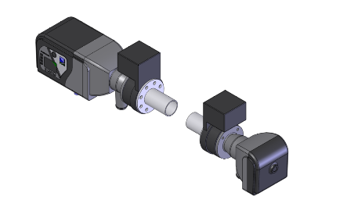
PCME STACK 710 – Key Benefits
The PCME STACK 710 is a continuous, cross stack, double pass transmissometer.
Easy maintenance and servicing
Ease of use with user interface at both transceiver and remote control unit
No continuously moving parts – high reliability
Patented LED technology and retro-reflector design for high accuracy and lower dust measurement than other Transmissometers
Compliant with all International Opacity standards
Shutters + Alignment
Purge Inlet

Slide 9
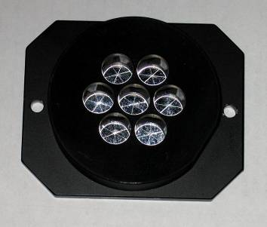
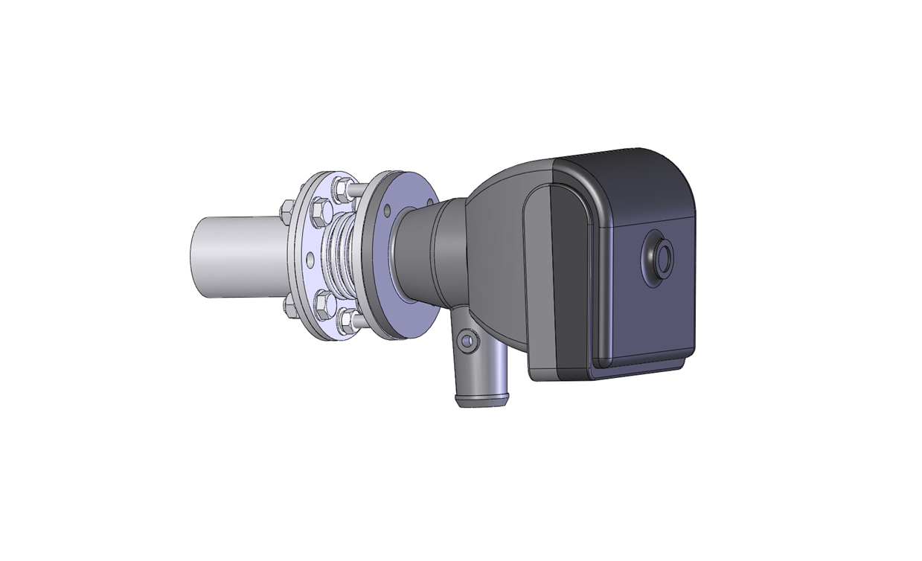
PCME STACK 710 - Patented Retro-reflector
Eliminates temperature drift found in traditional plastic retro-reflectors
Can lead to over reporting of emissions
Added Benefits
Longer path lengths
10m now available
Better signal to noise
Lower detection limits
Notes:
9

Slide 10
Stack 710 is a great Product for Transmissometer Applications
Large stack /high dust (EP or no controls)
Fossil Fuel Boilers and Power Plant
Sinter plant (steel)
Cement Kilns
Process conditions
Opacity 0- 10% and 0-100%
Dust : 10 – 500mg/m³
1 – 10m stack diameter
Non condensing flue gas
Strong performance versus major competitors
Durag: DR-290
Sick: Dust HunterT-200
TeledyneML : Light Hawk

Slide 11
Thank You

